Slide 1
Predictive Maintenance of Industrial Machinery
CAPSTONE PROJECT
Presented By:
Student Name : KETHAVATH TARUN NAIK
College Name : SRI INDU COLLEGE OF ENGINEERING AND TECHNOLOGY
Department : COMPUTER SCIENCE ENGINEERING (IOT)

Slide 2
OUTLINE
Problem Statement
Proposed System/Solution
System Development Approach
Algorithm & Deployment
Result (Output Image)
Conclusion
Future Scope
References

Slide 3
Problem Statement
A predictive maintenance model for a fleet of industrial machines to anticipate failures before they occur. This project will involve analyzing sensor data from machinery to identify patterns that precede a failure. The goal is to create a classification model that can predict the type of failure (e.g., tool wear, heat dissipation, power failure) based on real-time operational data. This will enable proactive maintenance, reducing downtime and operational costs.

Slide 4
Proposed Solution
The proposed solution is to develop a predictive maintenance system using machine learning to detect potential machine failures before they occur. By analyzing historical sensor data—such as temperature, torque, and tool wear—the model can learn patterns that precede various failure types. Using IBM Watson AutoAI, the system automatically builds and optimizes the best classification model without manual coding. The final model is deployed on IBM Watson Machine Learning to deliver real-time predictions through a REST API. This proactive approach helps reduce unexpected downtime, improve equipment reliability, and support data-driven maintenance strategies across industrial operations.

Slide 5
System Approach
The Predictive Maintenance system was developed using IBM Cloud’s integrated tools to enable a seamless machine learning workflow without writing code.
🔹 Step 1: Dataset Acquisition
Source: Kaggle Predictive Maintenance dataset
Data includes machine sensor readings: air temperature, torque, tool wear, rotational speed, etc.
🔹 Step 2: Data Upload and Storage
Dataset uploaded to IBM Cloud Object Storage
Connected to IBM Watson Studio for further processing
🔹 Step 3: Data Preparation (AutoAI)
Data refinement and transformation performed using Watson Studio's Data Refinery
Cleaned data saved as a new asset for modeling

Slide 6
Step 4: Model Building (AutoAI)
IBM AutoAI used to automatically:
Analyze data
Select best features
Train multiple models
Rank them based on accuracy
🔹 Step 5: Model Deployment
Best model (Snap Random Forest Classifier) deployed using IBM Watson Machine Learning
REST API generated for real-time predictions
🔹 Step 6: Model Testing and Results
Test interface used to simulate live input
Output displayed predicted failure type with confidence scores

Slide 7
Algorithm & Deployment
Algorithm Selection:
IBM AutoAI selected the Snap Random Forest Classifier as the best performing model with 99.5% accuracy.
Data Input:
Machine sensor parameters: air temperature, process temperature, torque, rotational speed, tool wear.
Training Process:
Supervised learning on labeled data indicating types of failure (or normal state).
Prediction Process:
The trained model is deployed on IBM Watson Machine Learning.
Predictions are made via an online REST API by submitting real-time sensor inputs.

Slide 8
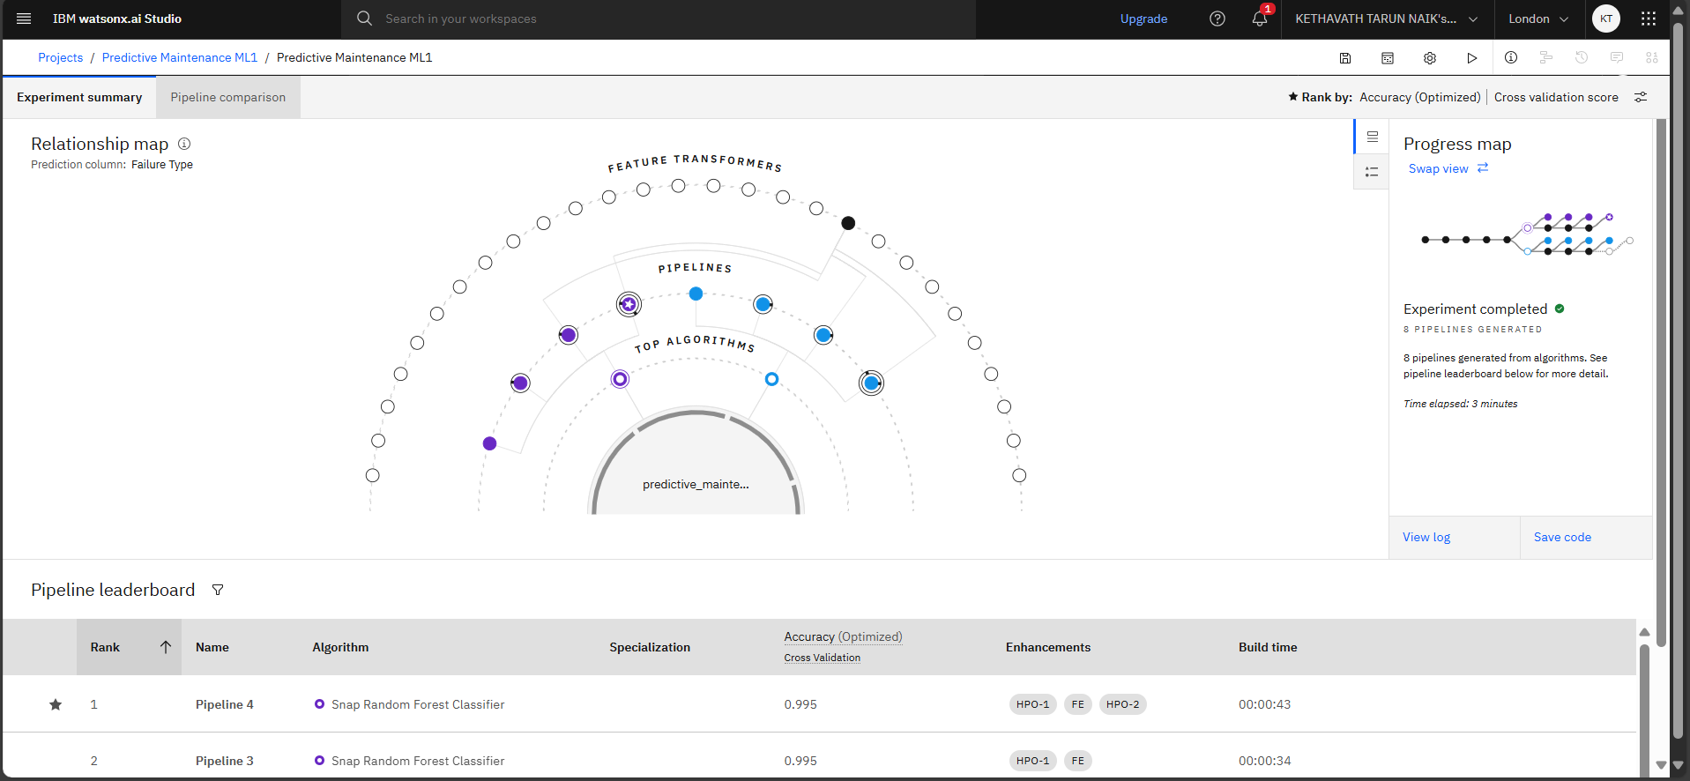
Result

Slide 9
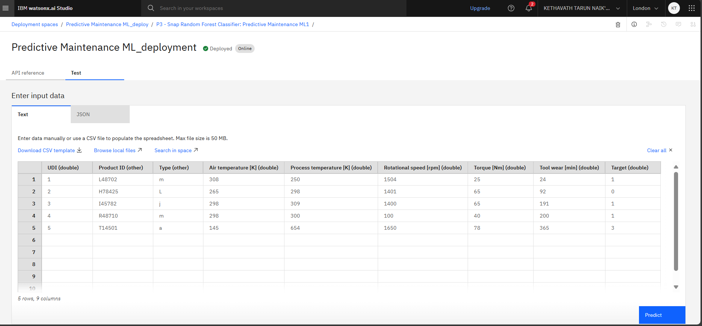

Slide 10
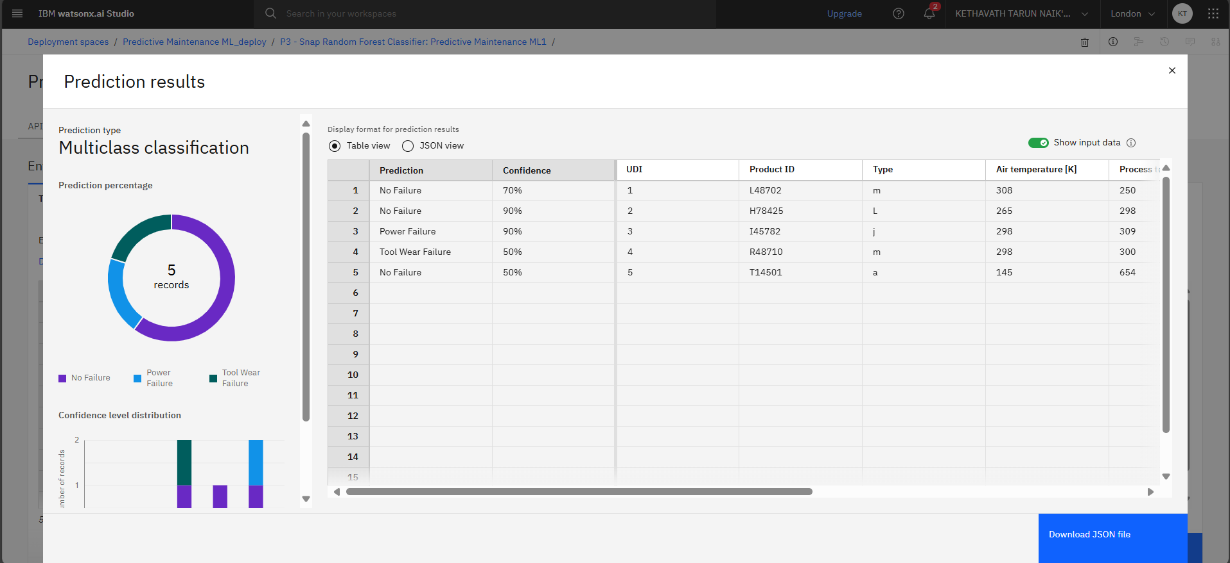

Slide 11
Conclusion
The predictive maintenance system developed using IBM Watson AutoAI successfully identifies potential machinery failures with high accuracy. By analyzing historical sensor data, the model can detect early signs of tool wear, power failure, and heat-related issues. The use of AutoAI simplified the model-building process by automating algorithm selection and optimization, while IBM Watson Machine Learning enabled seamless deployment through an online REST API. This solution enhances operational reliability, minimizes unexpected downtime, and supports smarter maintenance planning. Overall, the project demonstrates the effectiveness of machine learning in enabling proactive, data-driven decision-making within industrial environments.

Slide 12
Future scope
In the future, this predictive maintenance system can be enhanced by integrating real-time IoT sensor streaming to enable live monitoring of equipment health. Automated alert systems can be developed to notify operators via SMS or email when a potential failure is detected. The model can also be extended to support various types of industrial machinery beyond the current dataset. Additionally, a mobile application or web-based dashboard can be created for maintenance teams to easily access predictions and reports. Incorporating historical maintenance logs would further improve accuracy and enable more detailed root cause analysis.

Slide 13
References
Kaggle Dataset:https://www.kaggle.com/datasets/shivamb/machine predictive-maintenance-classification
IBM AutoAI and Cloud Lite Services
Research papers on predictive maintenance using ML
IBM Machine Learning Deployment Guide

Slide 14
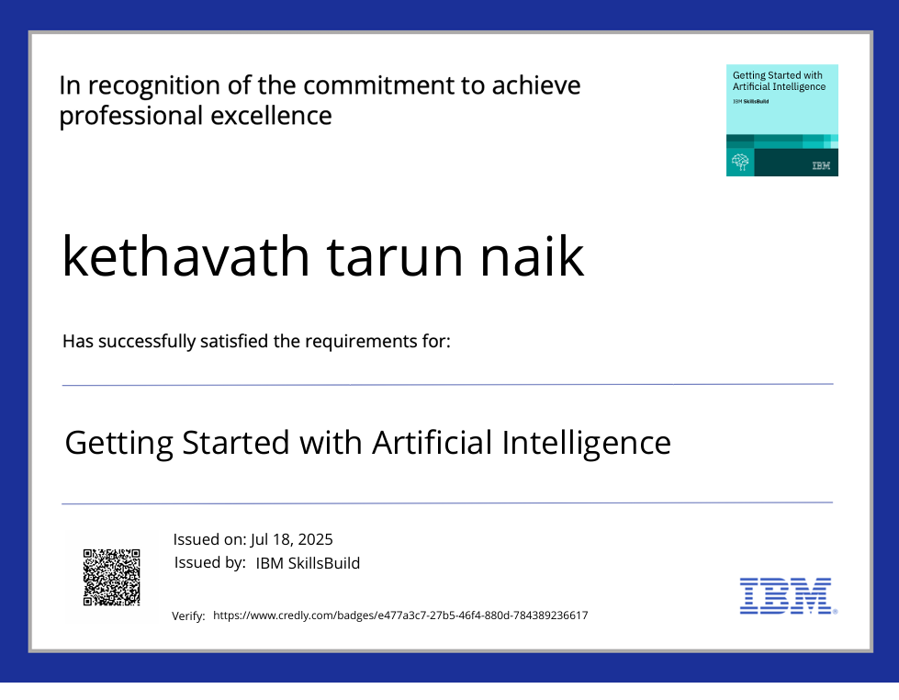
IBM Certifications
Getting started with Artificial Intelligence

Slide 15
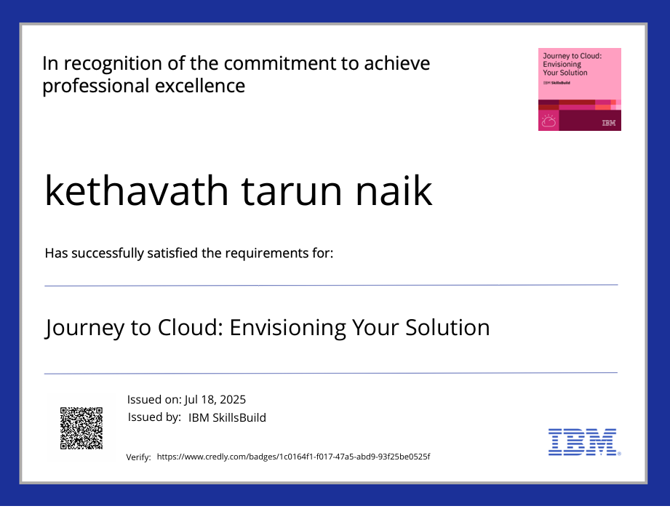
IBM Certifications
Journey to Cloud: Envisioning your Solution

Slide 16
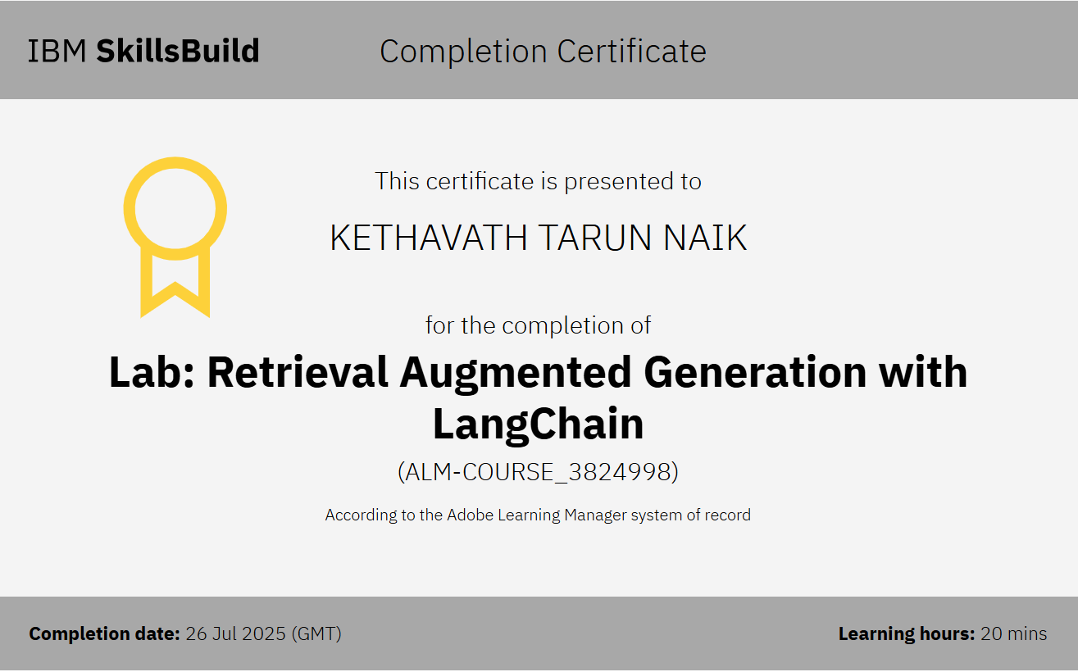
IBM Certifications
RAG LAB

Slide 17
THANK YOU

